Slide 1
Module 4: Probability Distribution and Sampling Theory
Sr. No. | Topics | Hours
4.1 | Probability Distribution: Poisson and Normal distribution | 7 hr
4.2 | Sampling distribution, Test of Hypothesis, Level of Significance, Critical region, One-tailed, and two-tailed test, Degree of freedom.
4.3 | Students’ t-distribution (Small sample). Test the significance of mean and Difference between the means of two samples. Chi-Square Test: Test of goodness of fit and independence of attributes, Contingency table.
 | Self-learning Topics: Test significance for Large samples, Estimate parameters of a population, Yate’s Correction.

Slide 2
Basic terminology and logic
Population
The populations we wish to study are almost always so large that we are unable to gather information from every case.
Eg. : If we are interested in the weights of students enrolled in the Engineering college
Population Size
The number of elements in the population is called the population size and is denoted by N.
Sample
A sample is a part of a population. - From the population, we select various elements on which we collect our data. This part of the population on which we collect data is called the sample.
Eg: Suppose that we are interested in studying the characteristics of the weights of the students enrolled in the college of engineering. If we randomly select 50 students among the students of the college of engineering and measure their weights, then the weights of these 50 students form our sample.
Sample Size
The number of elements in the sample is called the sample size and is denoted by n.

Slide 3
Sampling and Statistical Inference
There are several types of sampling techniques, some of which are:
1. Simple random sampling
If a sample of size ‘n’ is selected from a population ‘N’ in such a way that each element in the population has the same chance to be selected, the sample is called a simple random sample.
Eg. Suppose we want to know what percent of students at a large university work during the semester •then draw a sample of 500 from a list of all students (N=20,000) and write the name of each students in single paper and folded, mixed and now draw 500 of them. But its lengthy method so another way
Each student has a unique, 6 digit ID number that ranges from 000001 to 999999. Use a table of random numbers or a computer program to select 500 ID numbers with 6 digits each. Each time a randomly selected 6 digit number matches the ID of a student, that student is selected for the sample
2. Stratified Random Sampling:
In this type of sampling, the elements of the population are classified into several homogenous groups (strata). From each group, an independent simple random sample is drawn. The sample resulting from combining these samples is called a stratified random Sample.
Eg. Suppose we want to conduct a sample survey relating to lung cancer among smokers. Suppose the population of smokers is 1000 and that there are 300 pipe smokers, 500 cigarette smokers and 200 bidi smokers. Suppose we have to select sample of 250. i.e. 1/4th of the size of population. We have therefore to select 1/4th from each group/strata i.e. 75,125,and 50 from three strata respectively.

Slide 4
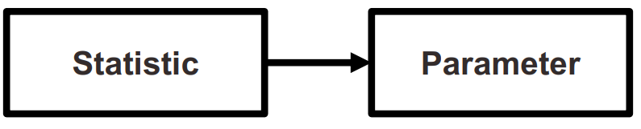
Sampling Distribution
Sampling distribution is the link between sample and population. The probability distribution of a statistic is called the sampling distribution of that statistic. The sampling distribution of the statistic is used to make statistical inference about the unknown parameter.
How ???
Statistics are used to estimate parameters
Statistics are mathematical characteristics of samples
Parameters are mathematical characteristics of populations

Slide 5
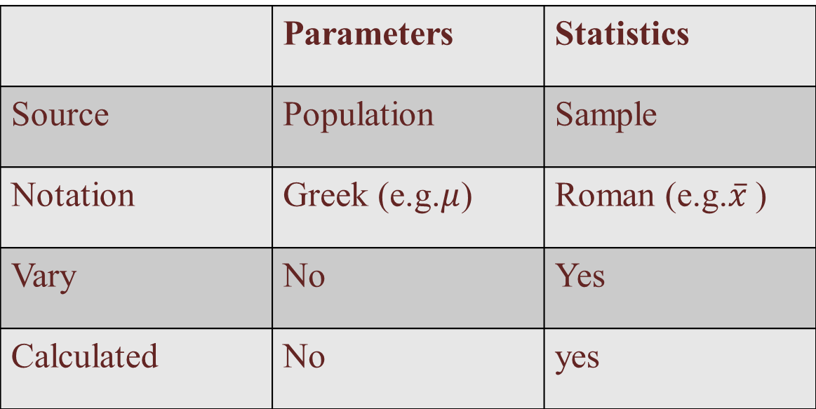
Distinctions Between Parameters and Statistics
 | Parameters | Statistics
Source | Population | Sample
Notation | Greek (e.g.$μ$) | Roman (e.g.$\overline{x}$ )
Vary | No | Yes
Calculated | No | yes

Slide 6
Sampling Distribution
A sampling distribution acts as a frame of reference for statistical decision making.
It is a theoretical probability distribution of the possible values of some sample statistic that would occur if we were to draw all possible samples of a fixed size from a given population.
The sampling distribution allows us to determine whether, given the variability among all possible sample means, the one we observed is a common out come or a rare outcome.
Imagine that each one of you asks a random sample of 10 people
in this class what their height is.
You each calculate the average height of your sample to get the
sample mean.
When you report back, would you expect all of your sample
means to be the same?
How much would you expect them to differ?

Slide 7
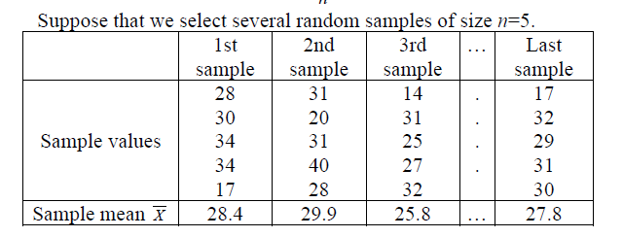
Sampling Distribution of the Mean
Random samples rarely exactly represent the underlying population. We rely on sampling distributions to give us a better idea whether the sample we’ve observed represents a common or rare outcome.
Sampling distribution of the mean: probability distribution of means for ALL possible random samples OF A GIVEN SIZE from some population, It describes the behavior of a sampling mean
ALL possible samples is a lot!
Example: All possible samples of size 5 from a class of 90 = 43949268

Slide 8
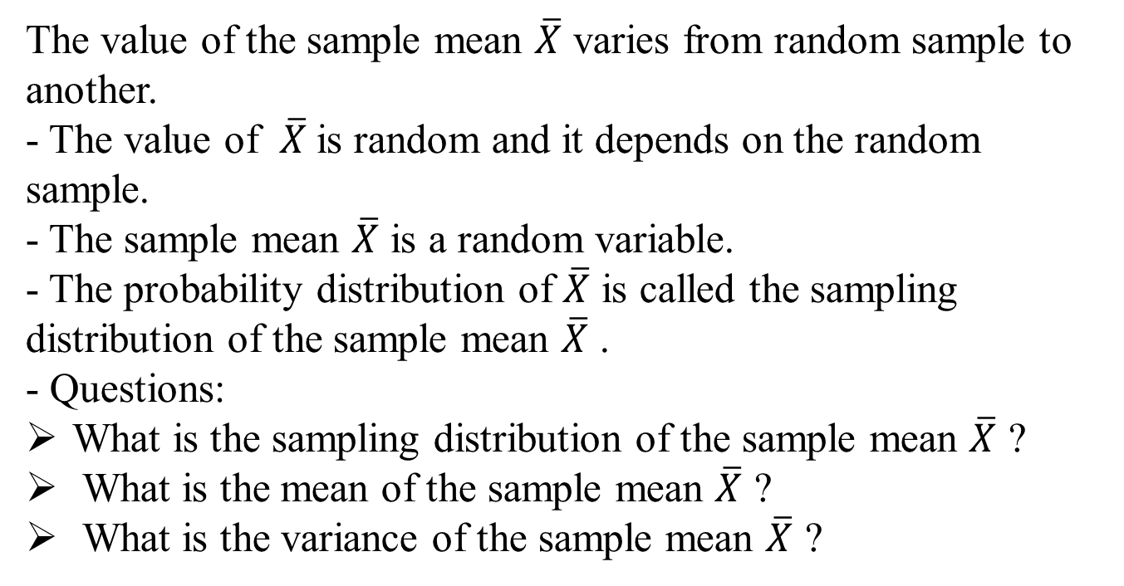
Sampling Distribution of the Mean
The value of the sample mean $\overline{X}$ varies from random sample to another.
- The value of $\overline{X}$is random and it depends on the random
sample.
- The sample mean $\overline{X}$ is a random variable.
- The probability distribution of $\overline{X}$ is called the sampling distribution of the sample mean $\overline{X}$ .
- Questions:
What is the sampling distribution of the sample mean $\overline{X}$ ?
What is the mean of the sample mean $\overline{X}$ ?
What is the variance of the sample mean $\overline{X}$ ?

Slide 9
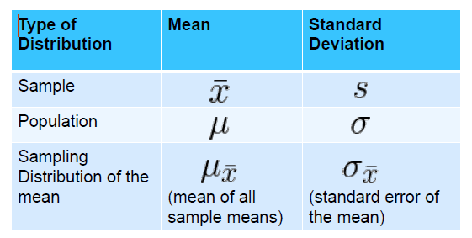
Sampling Distribution of the Mean

Slide 10
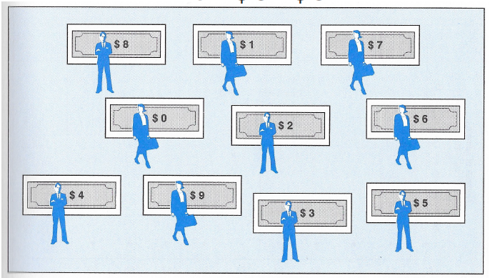
Sampling Distribution of the Mean
A population of 10 people with $0–$9

Slide 11
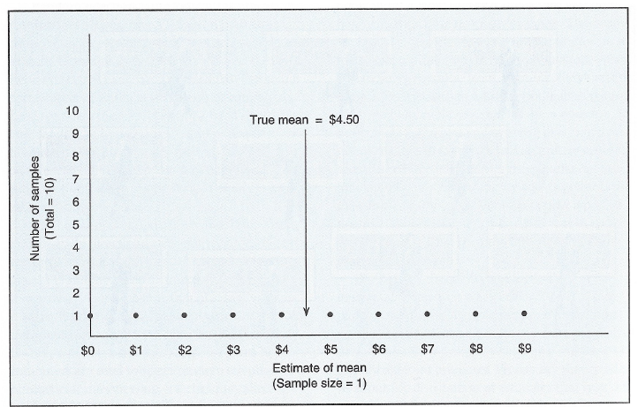
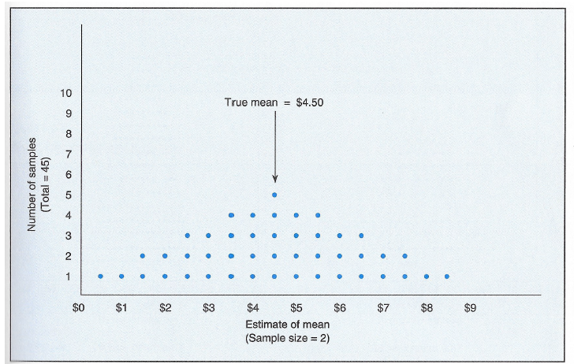
Sampling Distribution of the Mean
The sampling distribution (n=1)
The sampling distribution (n=2)

Slide 12
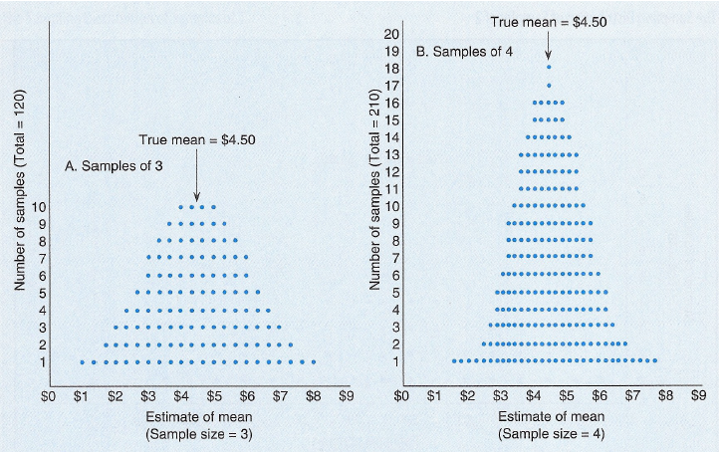
Sampling Distribution of the Mean

Slide 13
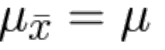
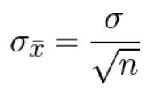
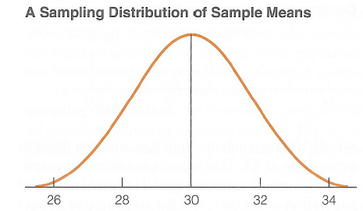
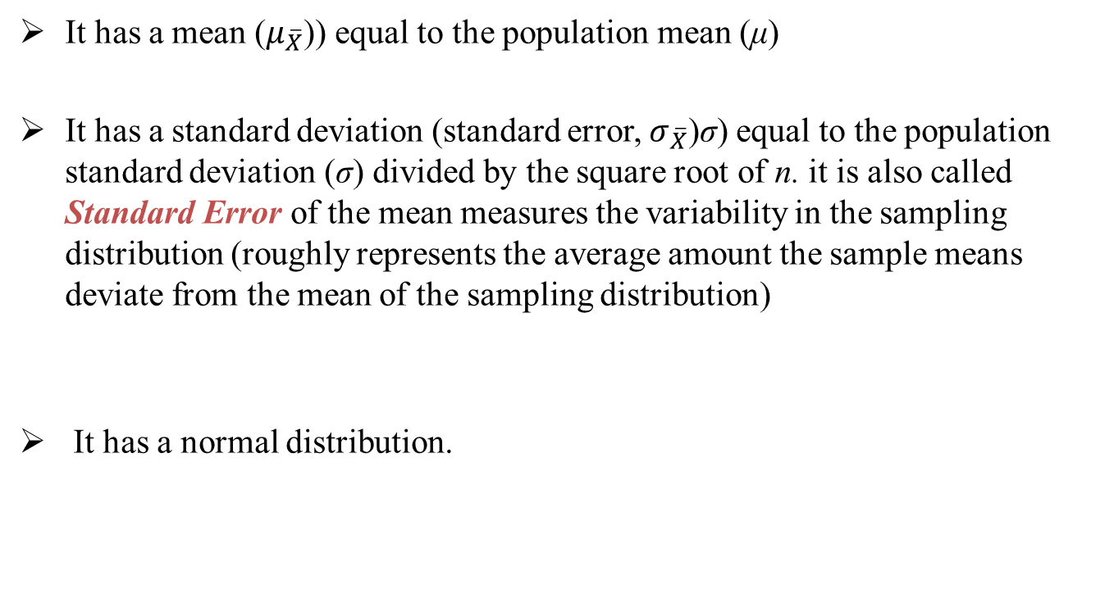
Properties of sampling distribution
It has a mean ($μ_{\overline{X}}$)) equal to the population mean (μ)
It has a standard deviation (standard error, $σ_{\overline{X}}$)σ) equal to the population standard deviation (σ) divided by the square root of n. it is also called Standard Error of the mean measures the variability in the sampling distribution (roughly represents the average amount the sample means deviate from the mean of the sampling distribution)
It has a normal distribution.

Slide 14
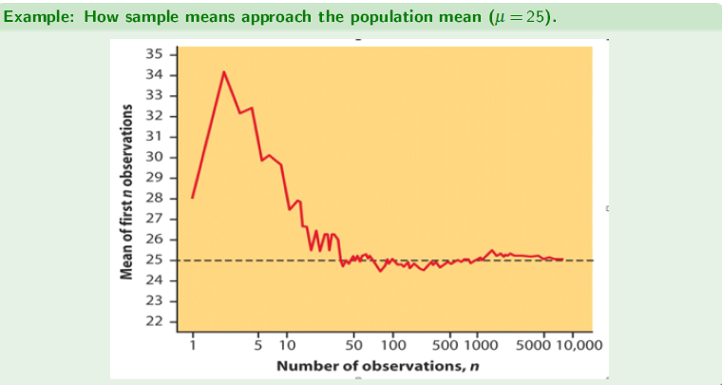
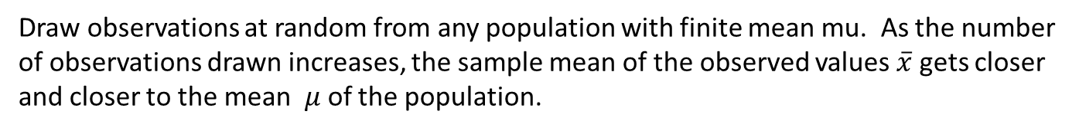
Sampling Distribution of the Mean
Draw observations at random from any population with finite mean mu. As the number of observations drawn increases, the sample mean of the observed values $\overline{x}$ gets closer and closer to the mean $μ$of the population.

Slide 15
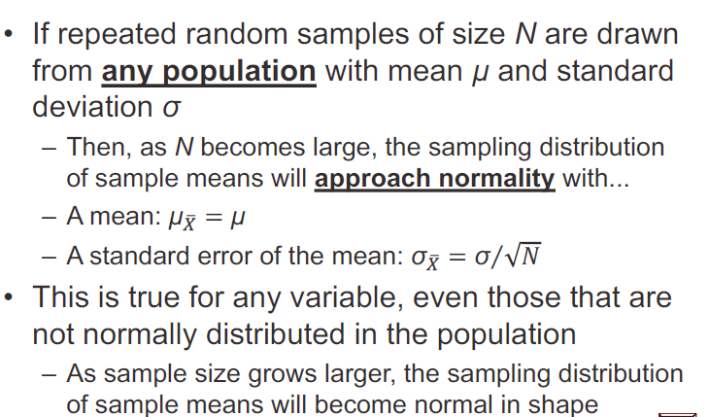
Central limit theorem

Slide 16
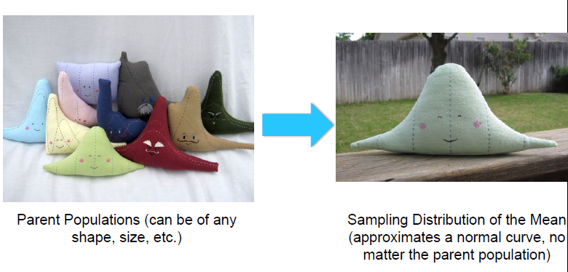
Central limit theorem
The importance of the central limit theorem is that it removes the constraint of normality in the population
– Applies to large samples (n≥30)
If the sample is small (N<30)
– We must have information on the normality of the population before we can assume the sampling distribution is normal

Slide 17
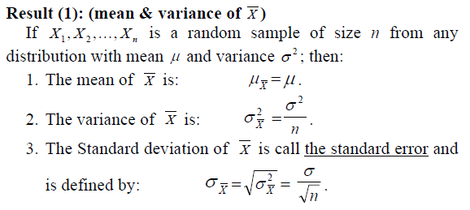
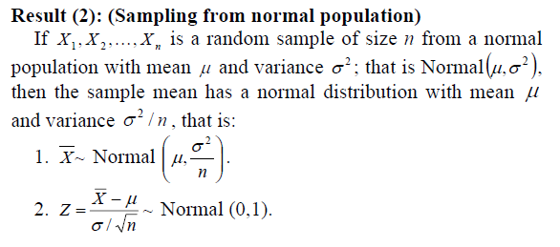

Some Results of sampling distribution of $\overline{X}$
We use this result when sampling from normal distribution with known variance $σ^{2}$
.

Slide 18
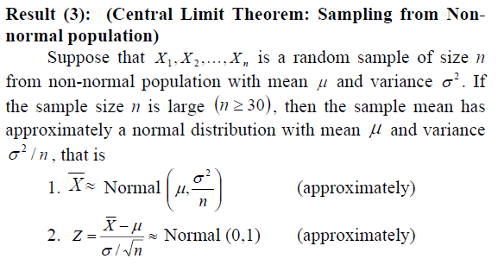
Some Results of sampling distribution of $\overline{X}$
Note: “≈ ” means “approximately distributed.
We use this result when sampling from non-normal distribution with known variance and with large sample size.

Slide 19
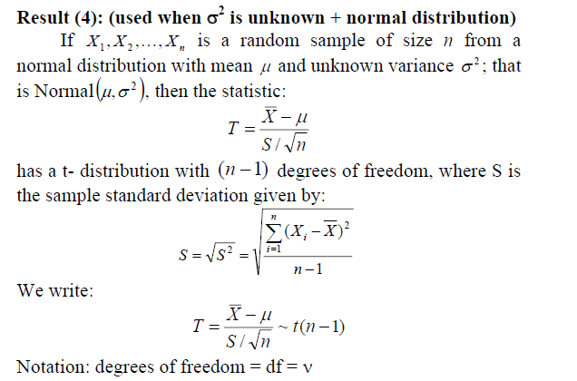
Some Results of sampling distribution of $\overline{X}$

Slide 20
Statistical Inferences: (Estimation and Hypotheses Testing)
It is the procedure by which we reach a conclusion about a population on the basis of the information contained in a sample drawn from that population.
There are two main purposes of statistics;
• Descriptive Statistics: Organization & summarization of the data
• Statistical Inference: Answering research questions about some unknown population parameters.
Estimation: Approximating (or estimating) the actual values of the unknown parameters:
Point Estimate: A point estimate is single value used to estimate the corresponding population parameter.
- Interval Estimate (or Confidence Interval): An interval estimate consists of two numerical values defining a range of values that most likely includes the parameter being estimated with a specified degree of confidence.
(2) Hypothesis Testing: Answering research questions about the unknown parameters of the population (confirming or denying some conjectures or statements about the unknown parameters).

Slide 21
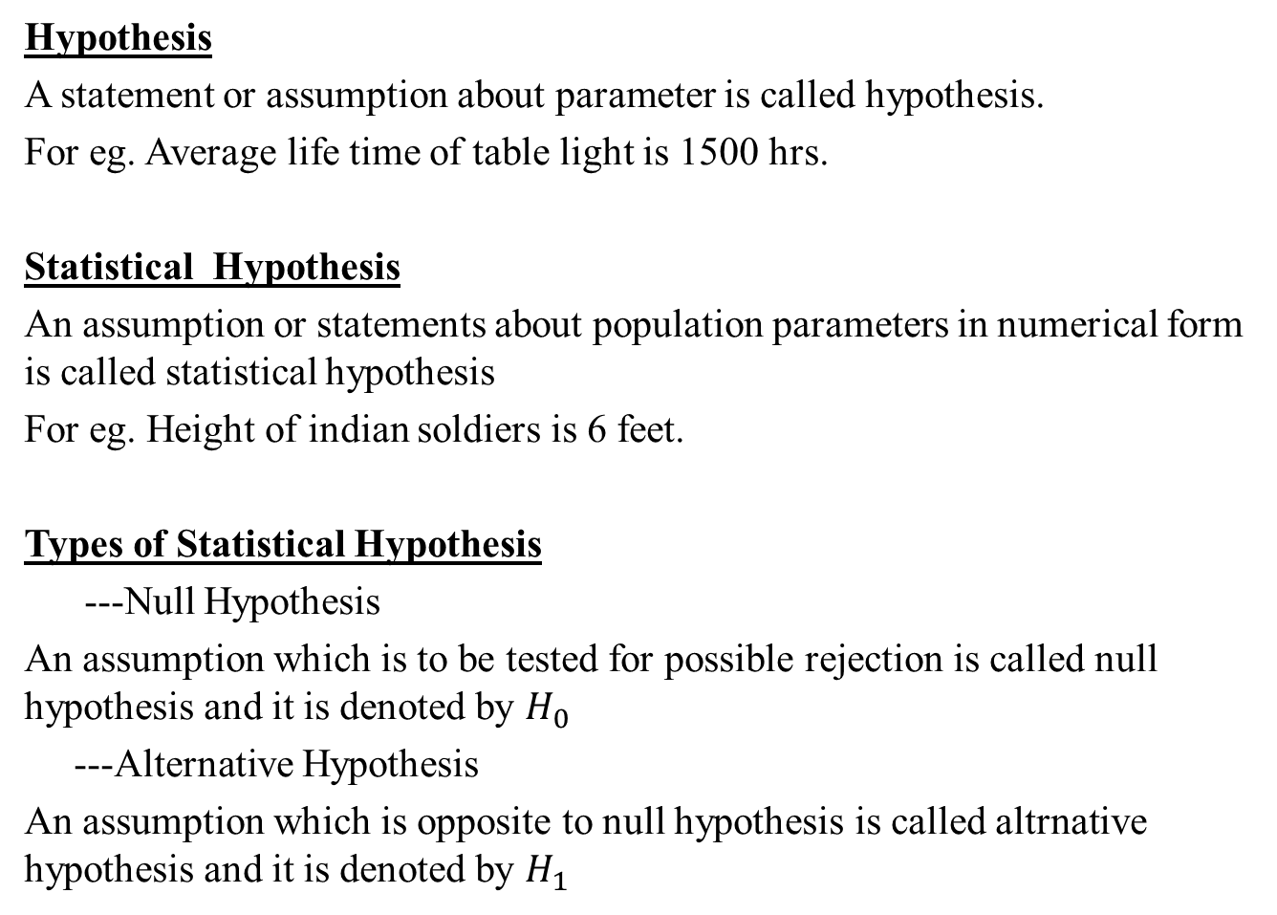
Hypothesis Testing
Hypothesis
A statement or assumption about parameter is called hypothesis.
For eg. Average life time of table light is 1500 hrs.
Statistical Hypothesis
An assumption or statements about population parameters in numerical form is called statistical hypothesis
For eg. Height of indian soldiers is 6 feet.
Types of Statistical Hypothesis
---Null Hypothesis
An assumption which is to be tested for possible rejection is called null hypothesis and it is denoted by $H_{0}$
---Alternative Hypothesis
An assumption which is opposite to null hypothesis is called altrnative hypothesis and it is denoted by $H_{1}$

Slide 22
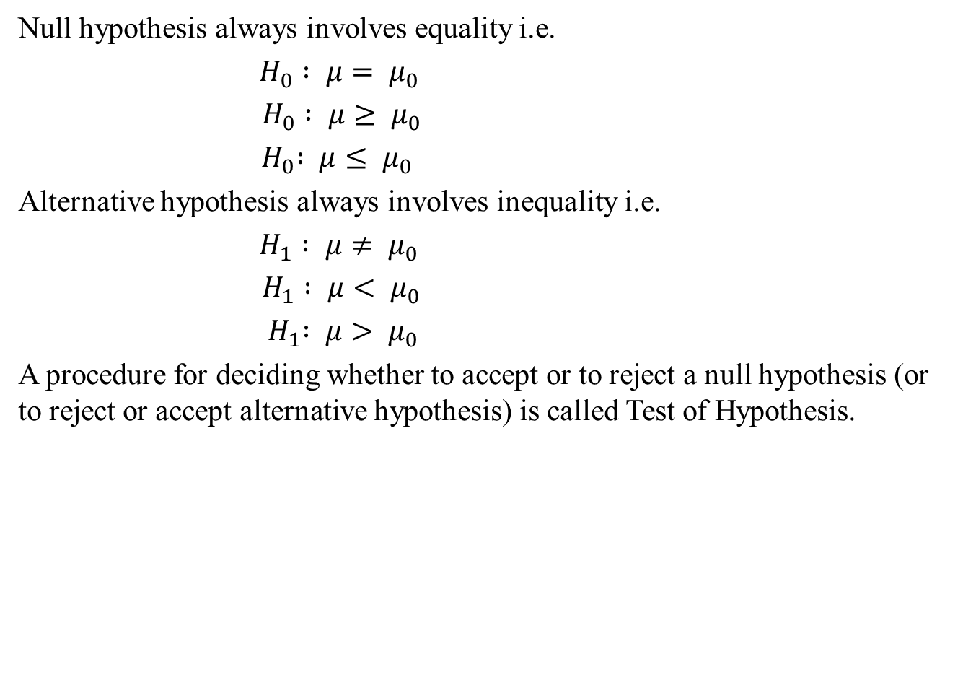
Hypothesis Testing
Null hypothesis always involves equality i.e.
$H_{0} : μ= μ_{0}$
$H_{0} : μ≥ μ_{0}$
${ H}_{0} : μ≤ μ_{0}$
Alternative hypothesis always involves inequality i.e.
$H_{1} : μ≠ μ_{0}$
$H_{1} : μ< μ_{0}$
${ H}_{1} : μ> μ_{0}$
A procedure for deciding whether to accept or to reject a null hypothesis (or to reject or accept alternative hypothesis) is called Test of Hypothesis.

Slide 23
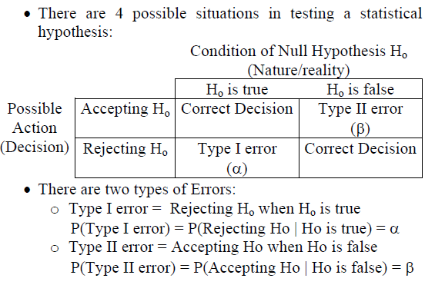
Type of Errors

Slide 24
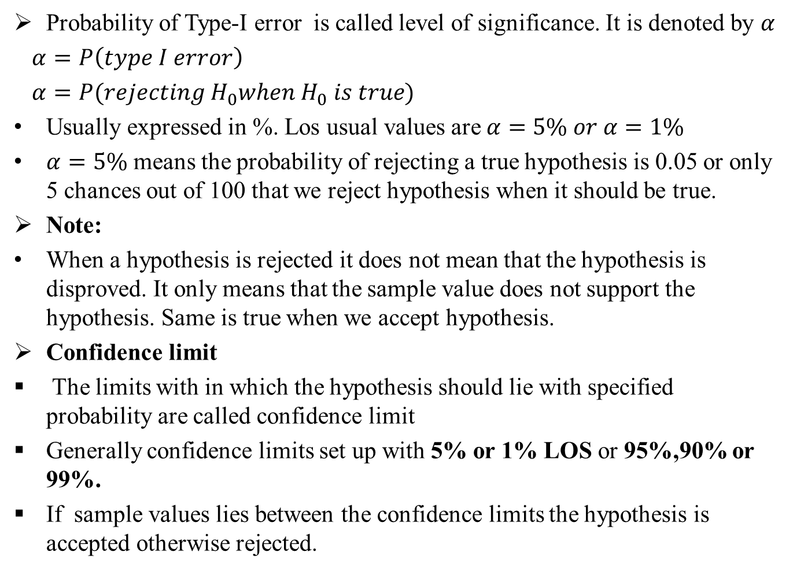
Level of Significance
Probability of Type-I error is called level of significance. It is denoted by $α$
$α=P\left(type I error\right)$
$α=P(rejecting H_{0}when H_{0} is true)$
Usually expressed in %. Los usual values are $α=5\% or α=1\%$
$α=5\%$ means the probability of rejecting a true hypothesis is 0.05 or only 5 chances out of 100 that we reject hypothesis when it should be true.
Note:
When a hypothesis is rejected it does not mean that the hypothesis is disproved. It only means that the sample value does not support the hypothesis. Same is true when we accept hypothesis.
Confidence limit
The limits with in which the hypothesis should lie with specified probability are called confidence limit
Generally confidence limits set up with 5% or 1% LOS or 95%,90% or 99%.
If sample values lies between the confidence limits the hypothesis is accepted otherwise rejected.

Slide 25
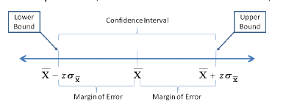
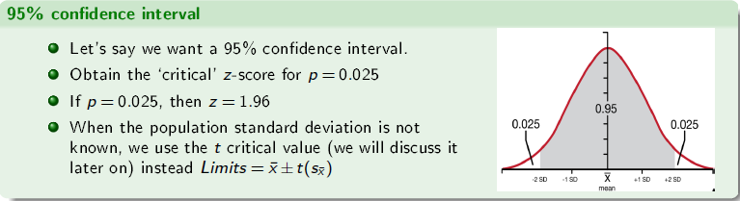
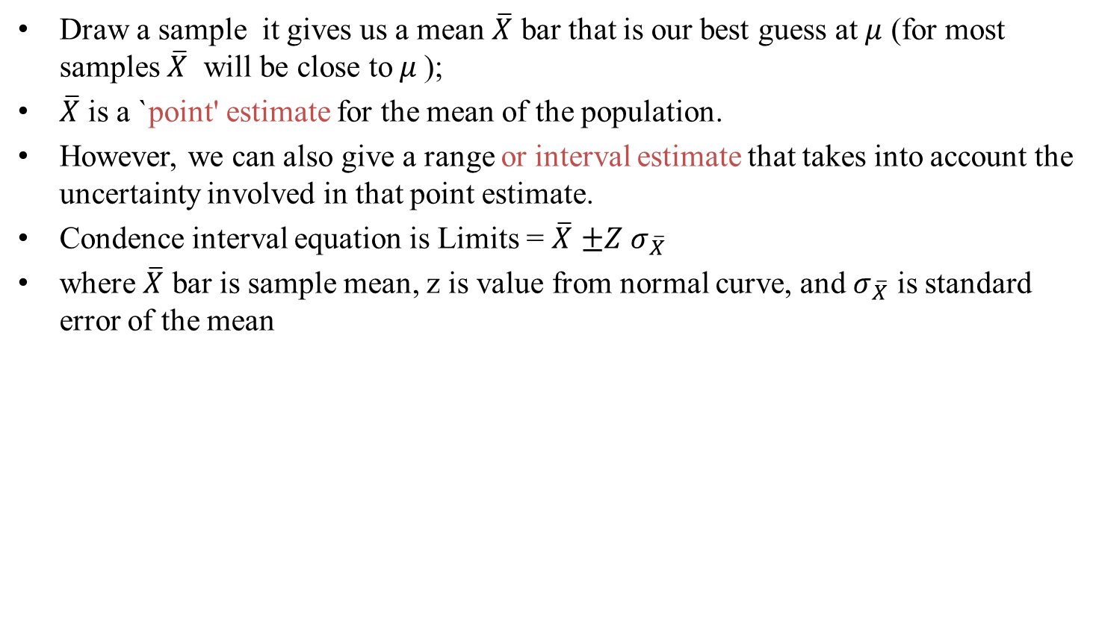
Confidence Interval
Draw a sample it gives us a mean $\overline{X}$ bar that is our best guess at $μ$ (for most samples $\overline{X}$ will be close to$μ$);
$\overline{X}$ is a `point' estimate for the mean of the population.
However, we can also give a range or interval estimate that takes into account the uncertainty involved in that point estimate.
Condence interval equation is Limits = $\overline{X}$ $±Z σ_{\overline{X}}$
where $\overline{X}$ bar is sample mean, z is value from normal curve, and $σ_{\overline{X}}$ is standard error of the mean

Slide 26
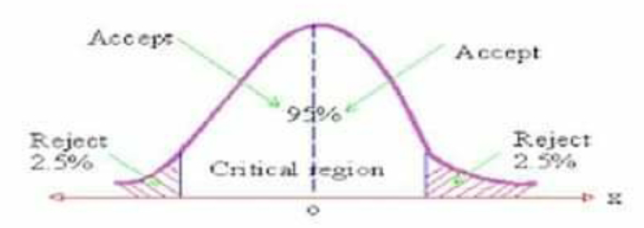
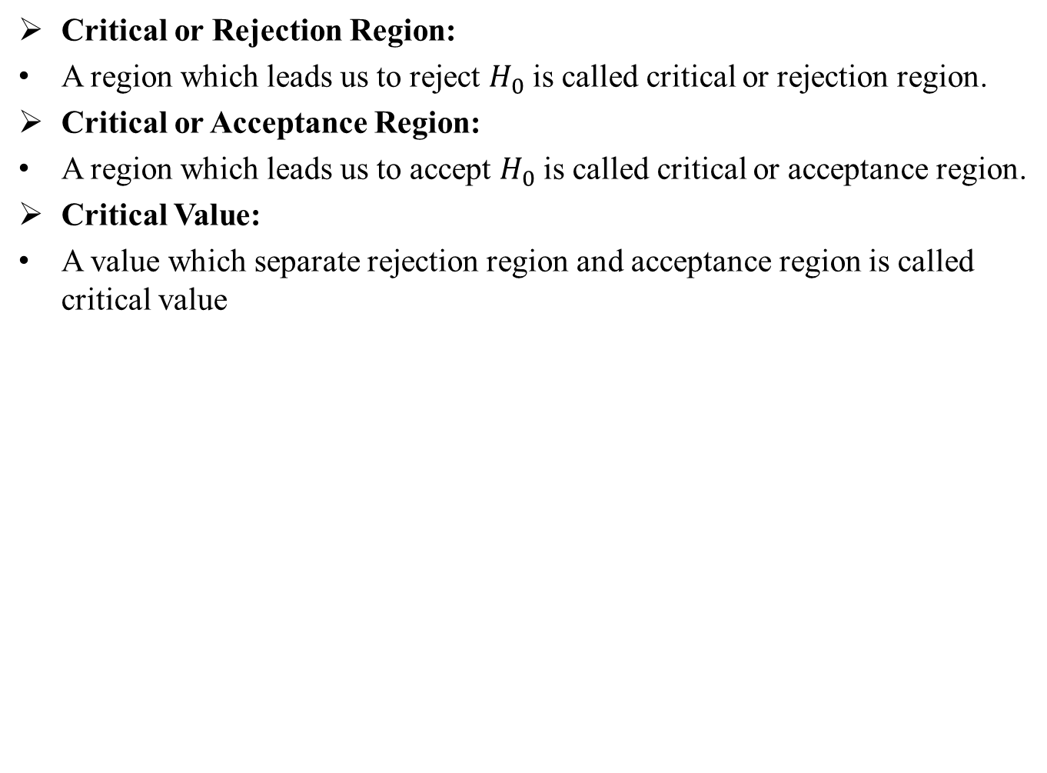
Critical region
Critical or Rejection Region:
A region which leads us to reject $H_{0}$ is called critical or rejection region.
Critical or Acceptance Region:
A region which leads us to accept $H_{0}$ is called critical or acceptance region.
Critical Value:
A value which separate rejection region and acceptance region is called critical value

Slide 27
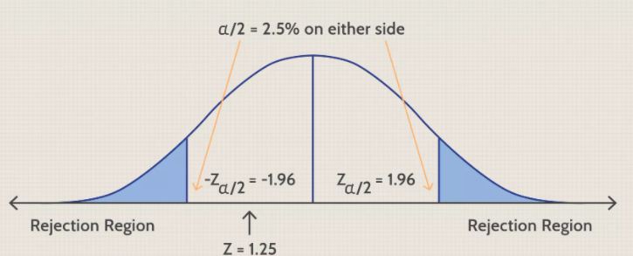
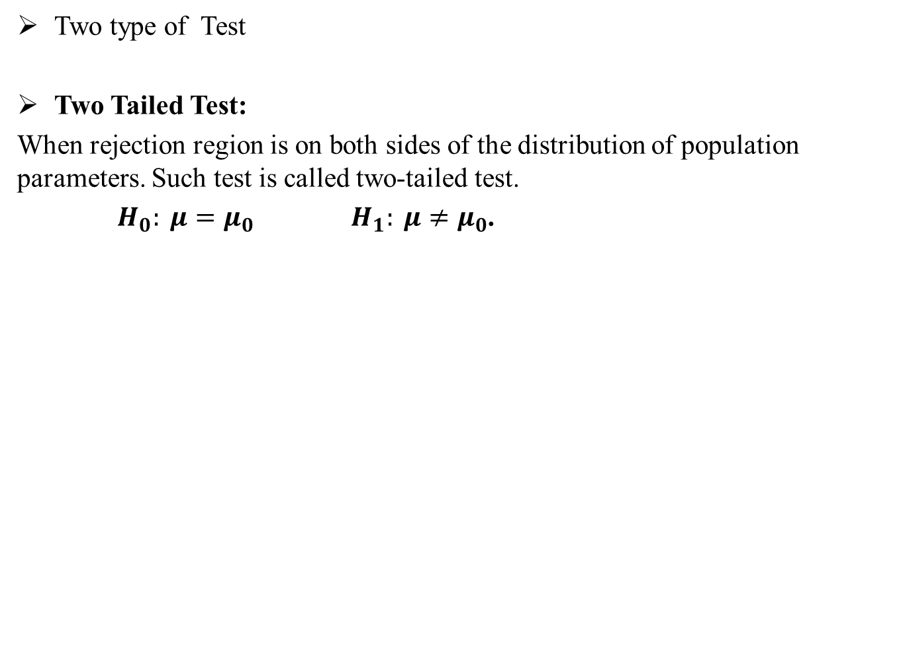
Type of Test
Two type of Test
Two Tailed Test:
When rejection region is on both sides of the distribution of population parameters. Such test is called two-tailed test.
$H_{0}: μ=μ_{0} H_{1}: μ≠μ_{0}$.

Slide 28
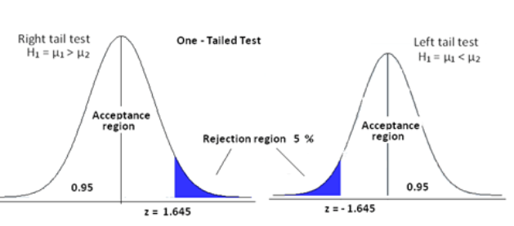
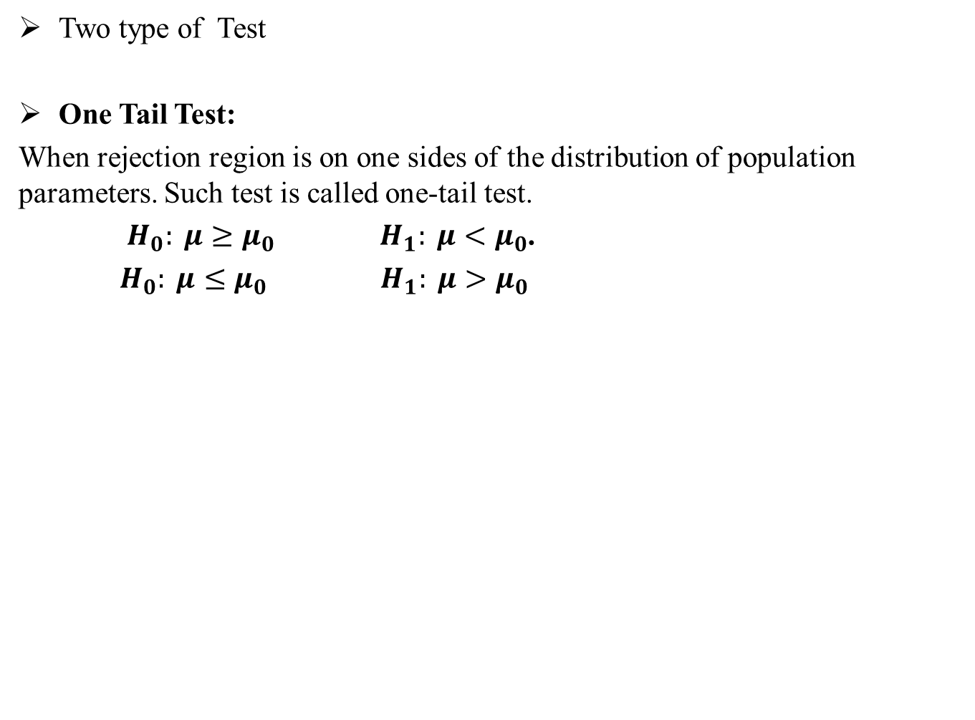
Type of Test
Two type of Test
One Tail Test:
When rejection region is on one sides of the distribution of population parameters. Such test is called one-tail test.
$H_{0}: μ≥μ_{0} H_{1}: μ<μ_{0}$.
$H_{0}: μ{≤μ}_{0} H_{1}: μ>μ_{0}$

Slide 29
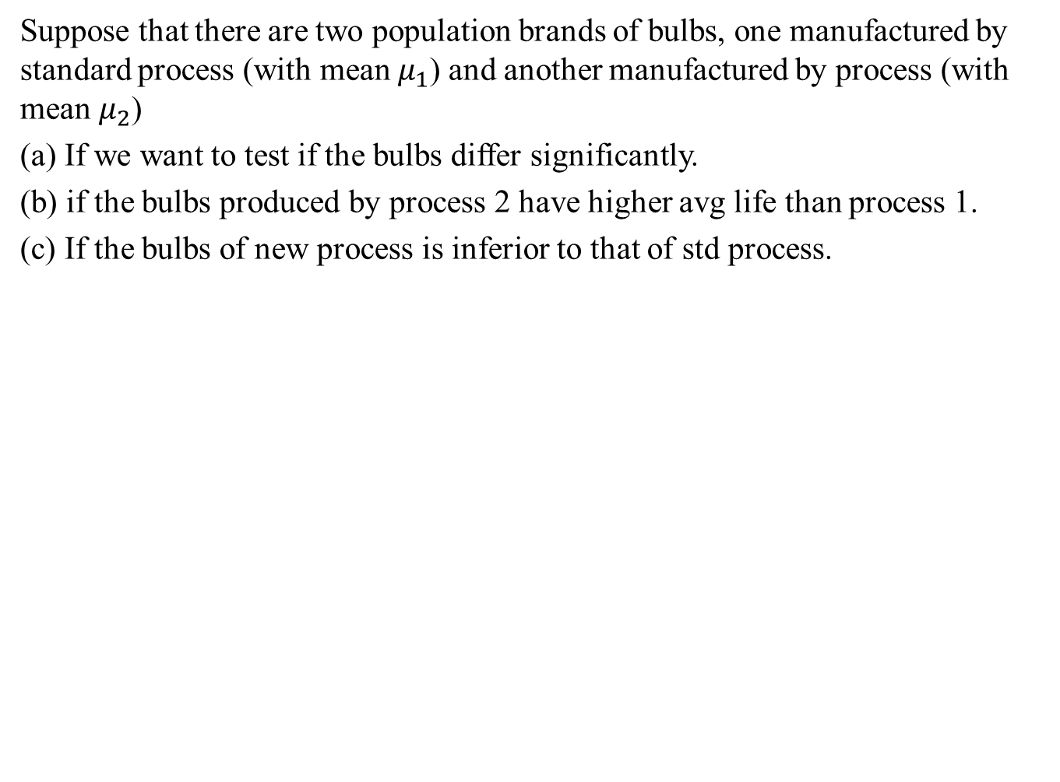
When to apply one tailed or two tailed test
Suppose that there are two population brands of bulbs, one manufactured by standard process (with mean $μ_{1}$) and another manufactured by process (with mean $μ_{2}$)
(a) If we want to test if the bulbs differ significantly.
(b) if the bulbs produced by process 2 have higher avg life than process 1.
(c) If the bulbs of new process is inferior to that of std process.

Slide 30
Small Sample Test

Slide 31
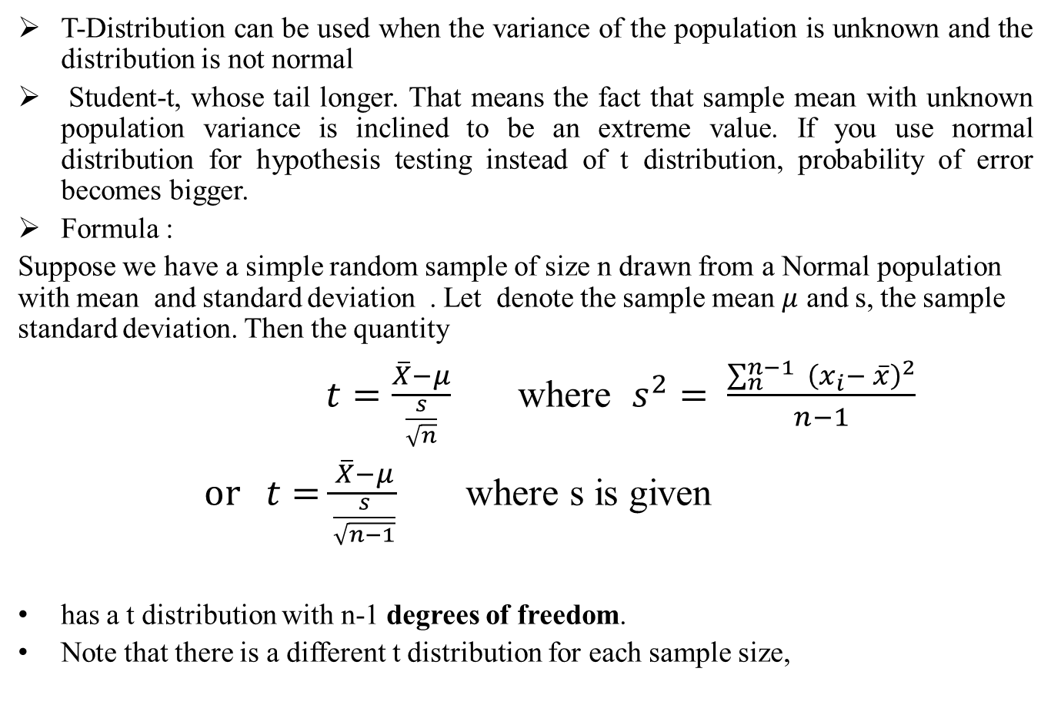
Student t-Distribution
T-Distribution can be used when the variance of the population is unknown and the distribution is not normal
Student-t, whose tail longer. That means the fact that sample mean with unknown population variance is inclined to be an extreme value. If you use normal distribution for hypothesis testing instead of t distribution, probability of error becomes bigger.
Formula :
Suppose we have a simple random sample of size n drawn from a Normal population with mean and standard deviation . Let denote the sample mean $μ$ and s, the sample standard deviation. Then the quantity
$t=\frac{\overline{X}−μ}{\frac{s}{\sqrt{n}}}$ where $s^{2}= \frac{\sum_{n}^{n−1}{ {\left(x_{i}− \overline{x}\right)}^{2}}}{n−1}$
$or t=\frac{\overline{X}−μ}{\frac{s}{\sqrt{n−1}}}$ where s is given
has a t distribution with n-1 degrees of freedom.
Note that there is a different t distribution for each sample size,

Slide 32
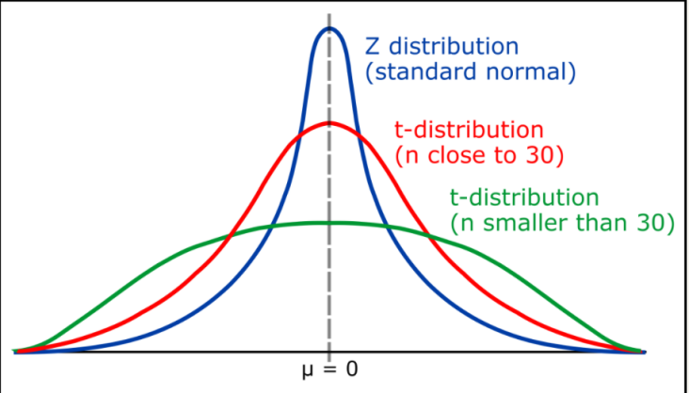
Properties of Student t-Distribution
The graph for the Student’s t-distribution is similar to the standard normal curve.
The mean for the Student’s t-distribution is zero and the distribution is symmetric about zero. The variance is greater than one, but approaches one from above as the sample size increases.
The Student’s t-distribution has more probability in its tails than the standard normal distribution because the spread of the t-distribution is greater than the spread of the standard normal. So the graph of the Student’s t-distribution will be thicker in the tails and shorter in the center than the graph of the standard normal distribution.
The exact shape of the Student’s t-distribution depends on the degrees of freedom. As the degrees of freedom increases, the graph of Student’s t-distribution becomes more like the graph of the standard normal distribution. For n > 30, the differences are negligible.

Slide 33
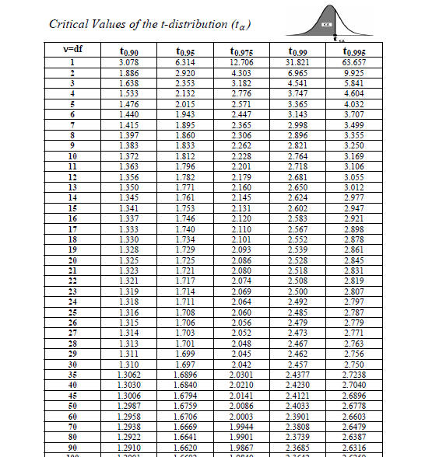
T-Distribution

Slide 34
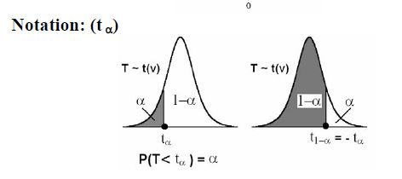
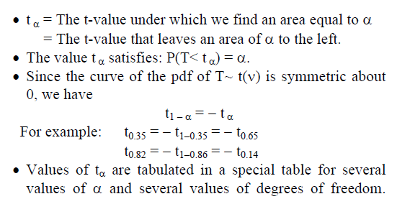
T-Distribution

Slide 35
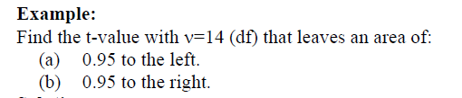
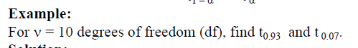
Examples: t-Distribution

Slide 36
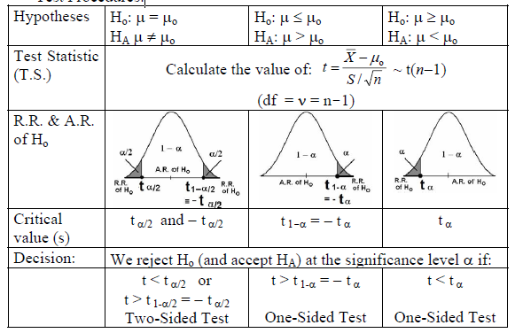
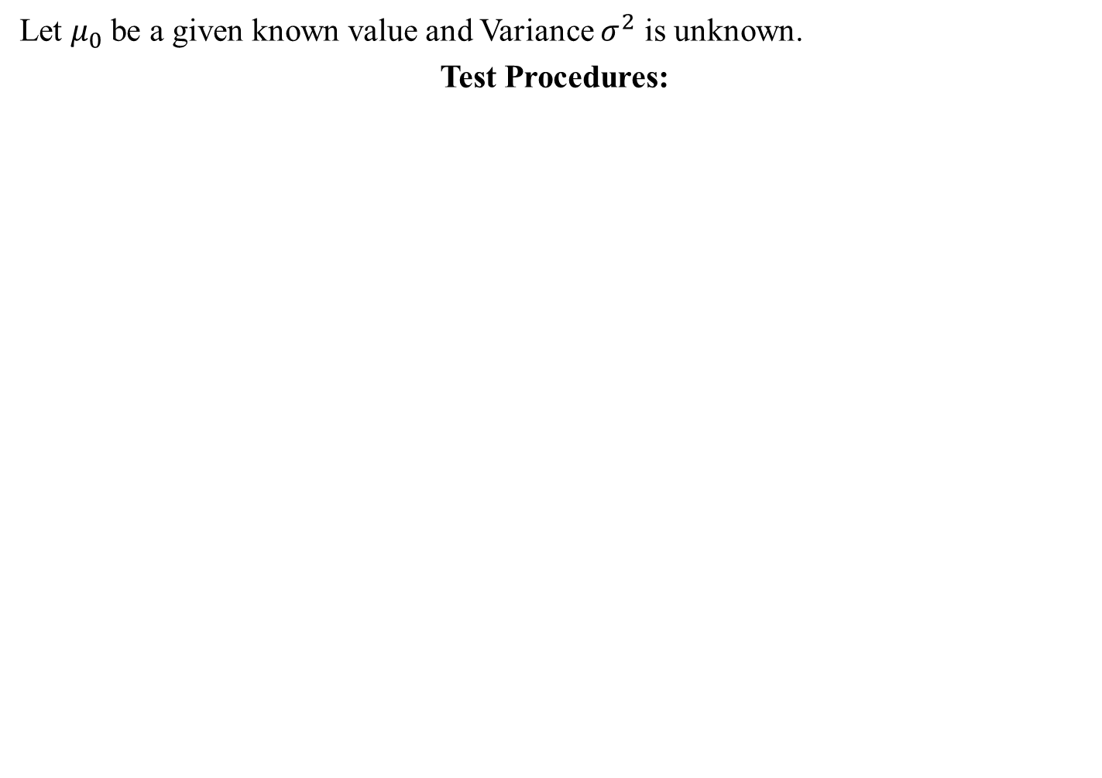
The Procedure for hypotheses testing about the mean (μ)
Let $μ_{0}$ be a given known value and Variance $σ^{2}$ is unknown.
Test Procedures:

Slide 37
Test the significance of mean
Qu.1A soap manufacturing company was distributing a particular brand of soap through a large number of retail shops. Before a heavy advertisement campaign the mean sale per week per shop was140 dozens. After the campaign, a sample of 26 shops was taken and the mean sales was found to be 147 dozens with standard deviation 16. Can you consider the advertisement effective?

Slide 38
Test the significance of mean
Qu.2 A random sample of size 16 from normal population showed a mean of 103.75 cm. and sum of squares of deviations from mean 843.75 square cm. Can we say that population has a mean of 108.75 cm?

Slide 39
Test the significance of mean
Qu.3 Problem 27.11
Qu.4 Problem 27.12

Slide 40
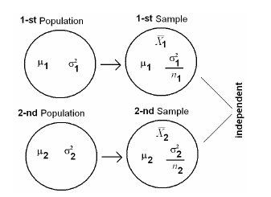
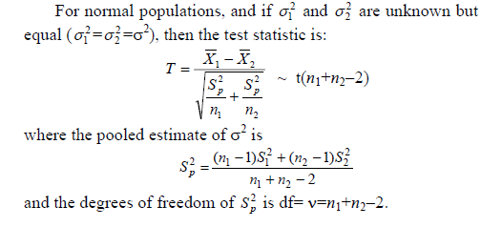
Test of Difference between the means of two samples.
•
Hypotheses: We choose one of the following situations:
Ho: μ1 = μ2 against H1: μ1 ≠ μ2
(ii) Ho: μ1 ≥ μ2 against H1: μ1 < μ2
(iii) Ho: μ1 ≤ μ2 against H1: μ1 > μ2 or equivalently,
Ho: μ1-μ2 = 0 against H1: μ1 - μ2 ≠ 0
(ii) Ho: μ1-μ2 ≥ 0 against H1: μ1 - μ2 < 0
(iii) Ho: μ1-μ2 ≤ 0 against H1: μ1 - μ2 > 0

Slide 41
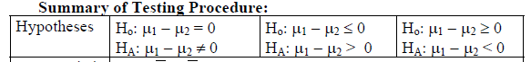
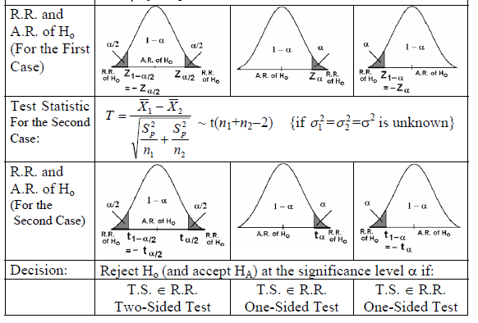
Test of Difference between the means of two samples.
•

Slide 42
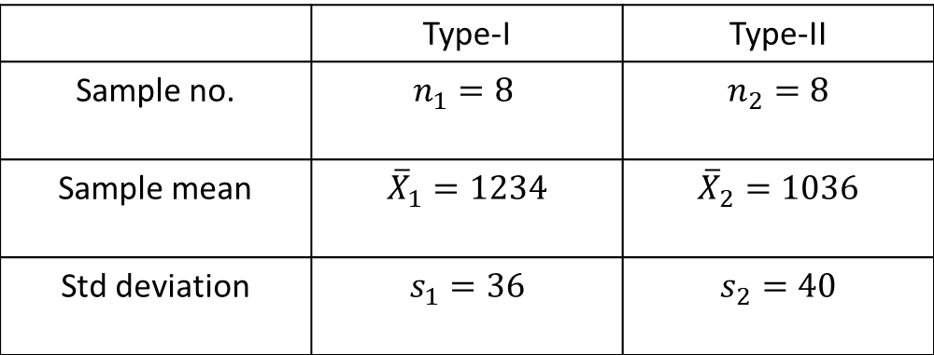
Test of Difference between the means of two samples.
•
Sample of two types of electric light bulbs were tested for length of life and following data obtained .
 | Type-I | Type-II
Sample no. | $$n_{1}=8$$ | $$n_{2}=8$$
Sample mean | $${\overline{X}}_{1}=1234$$ | $${\overline{X}}_{2}=1036$$
Std deviation | $$s_{1}=36$$ | $$s_{2}=40$$

Slide 44
Paired t-test for difference of mean.
If n1=n2=n (sample size are same)
And Two samples are not independent (or correlated).
Samples observations are paired together.
Examples of related populations are:
1. Height of the father and height of his son.
2. Mark of the student in MATH and his mark in STAT.
3. Pulse rate of the patient before and after the medical treatment.
4. Hemoglobin level of the patient before and after the medical treatment.
Example: (effectiveness of a diet program) Suppose that we are interested in studying the effectiveness of a certain diet program. Let the random variables X and Y are as follows:
X = the weight of the individual before the diet program
Y= the weight of the same individual after the diet program
Populations:
1-st population (X): weights before a diet program mean = μ1
2-nd population (Y): weights after the diet program mean = μ2

Slide 45
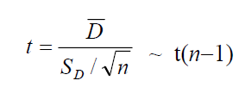


Hypotheses:
Ho: the diet program has no effect on weight
H1: the diet program has an effect on weight Equivalently,
Ho: μ1 = μ2 H1: μ1 ≠ μ2
Equivalently, Ho: μ1 - μ2 = 0 H1: μ1 - μ2 ≠ 0
Equivalently, Ho: μD = 0 H1: μD ≠ 0 where: μD = μ1 - μ2
Test Statistic:
Where
Di = Xi - Yi (i=1, 2, …, n)

Slide 47



Does these data provide sufficient evidence to allow us to conclude that the diet program is effective? Use α=0.05 and assume that the populations are normal.
Solution:
μ1 = the mean of weights before the diet program
μ2 = the mean of weights after the diet program Hypotheses:
Ho: μ1 = μ2 (Ho: the diet program is not effective)
H1: μ1 ≠ μ2 (HA: the diet program is effective)

Slide 48


Degrees of freedom: df= ν= n-1 = 10-1=9
Significance level: α=0.05
Rejection Region of Ho: Critical values: t 0.025 = - 2.262 and 2.262 Critical Region: t < - 2.262 or t > 2.262
Decision:
Since t= 2.43 ∈R.R., i.e., t=2.43 > 2.262,
we reject: Ho: μ1 = μ2 (the diet program is not effective) and
we accept: H1: μ1 ≠ μ2 (the diet program is effective)
Consequently, we conclude that the diet program is effective at α=0.05.

Slide 49

Chi-Square($χ^{2})Test$

Slide 50
Chi-Square($χ^{2})Test$
Non-Parmetric Test
A measure of the difference between the observed and expected frequencies of the outcomes of a set of events or variables.
χ2 depends on the size of the difference between actual and observed values, the degrees of freedom, and the samples size.
Can be used to test whether two variables are related or independent from one another or to test the goodness-of-fit between an observed distribution and a theoretical distribution of frequencies.
Can be applied to only categorical data type e.g containing groups/categories of gender, marital status, inoculated, age group etc.
Data to be presented in tabular form.

Slide 51


Statistical Inferences: (Estimation and Hypotheses Testing)
It is the procedure by which we reach a conclusion about a population on the basis of the information contained in a sample drawn from that population.
There are two main purposes of statistics;
• Descriptive Statistics: Organization & summarization of the data
• Statistical Inference: Answering research questions about some unknown population parameters.
Estimation: Approximating (or estimating) the actual values of the unknown parameters:
Point Estimate: A point estimate is single value used to estimate the corresponding population parameter.
- Interval Estimate (or Confidence Interval): An interval estimate consists of two numerical values defining a range of values that most likely includes the parameter being estimated with a specified degree of confidence.
(2) Hypothesis Testing: Answering research questions about the unknown parameters of the population (confirming or denying some conjectures or statements about the unknown parameters).

Slide 52

Hypothesis Testing Using Chi-Square($χ^{2})Test$
Set up Null Hypothesis (No significant difference between the observed and expected values/No association between the mentioned attributes) and Alternate Hypothesis.
Identify the degrees of freedom, n-1 OR(r-1)(c-1), where r = no. of rows, c = no.of columns.
Test statistc $χ_{c}^{2}\text{=}\sum{\frac{{\left(O_{i}−E_{i}\right)}^{2}}{E_{i}}}\text{​}$
$\text{where}\text{:}\text{c}\text{=}\text{Degrees} \text{of} \text{freedom}\text{;}O_{i}\text{=}\text{Observed} \text{value}\text{(}\text{s}\text{)}\text{;}E_{i}\text{=}\text{Expected} \text{value}\text{(}\text{s}\text{)​}$
Determine the critical value of $χ^{2}$from the table.
Compare the calculated and tabulated results.
Make Decision as $H_{0}$is rejected or $H_{0}$is not rejected on the basis if the calculated test statistic value falls in rejection region or acceptance region respectively.

Slide 53
Problems-1Chi square test for goodness of fit
A die is thrown 132 times with the following results:
Number turned up:
Frequency:
Test the hypothesis that the die is unbiased.
1 | 2 | 3 | 4 | 5 | 6
16 | 20 | 25 | 14 | 29 | 28

Slide 54
Problems-2 Chi square test for goodness of fit
The theory predicts the proportion of beans in the four groups A,B,C and D should be 9:3:3:1. In an experiment among 1600 beans, the number in the four groups were 882,313, 287,118. Does the experimental results support theory?

Slide 55
Problems-3 Chi square test Independence of Attributes
A certain drug was administered to 456 males out of total 720 in a certain locality to test its efficacy against typhoid. The incidence of typhoid is shown below. Find out the effectiveness of the drug against the disease.
 | Infection | No Infection | Total
Administered the drug | 144 | 312 | 456
Without Administered the drug | 192 | 72 | 264
Total | 336 | 384 | 720

Slide 56
Problems-4 Chi square test Independence of Attributes
An app provides ratings to three categories of restaurants under three categories. Can we conclude that the ratings are related to the size of the restaurant? Small Medium Large Total Good: 20 10 17 47 Okay: 11 8 8 27
Not Recommended: 10 7 9 26 Total: 41 25 34 100

